Slide 1
UK Election 2024
February 2024
June 2024
Adam Jackson
Policy-Purpose Consulting

Slide 2
Contents
What will the result be?
What happens next?
What are the policies and priorities?
So what? – Opportunities and risks

Slide 3
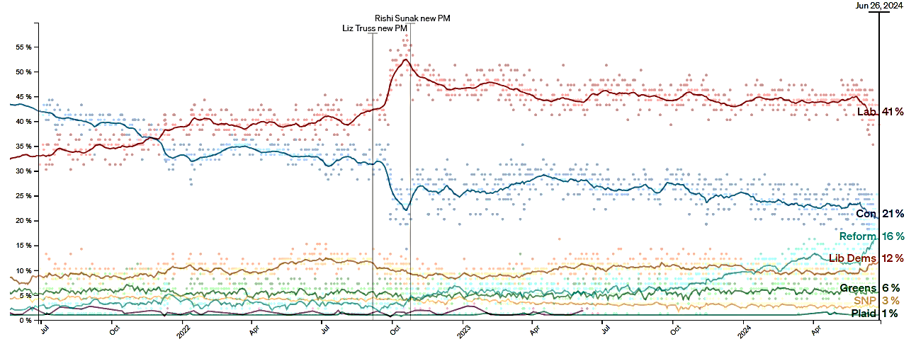
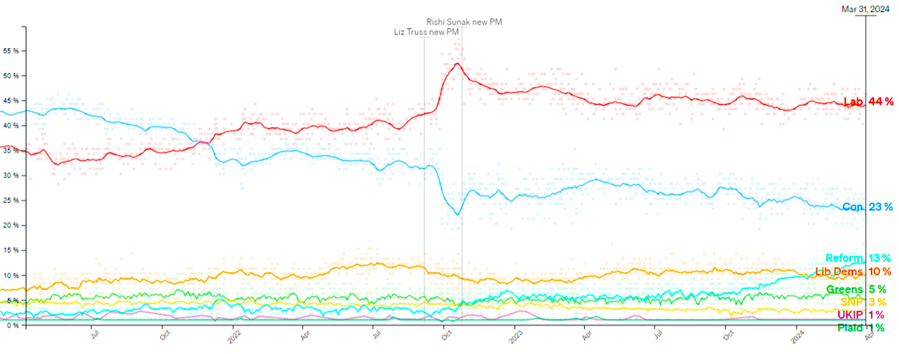
What will the result be?
Polling – last 3 years
source: https://www.politico.eu/europe-poll-of-polls/united-kingdom/
3

Slide 4
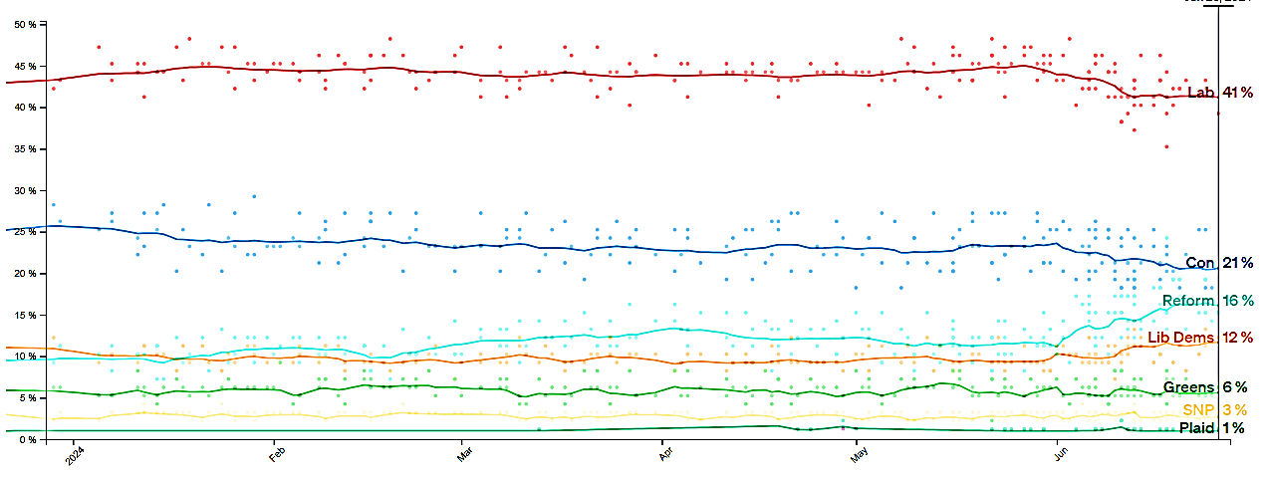
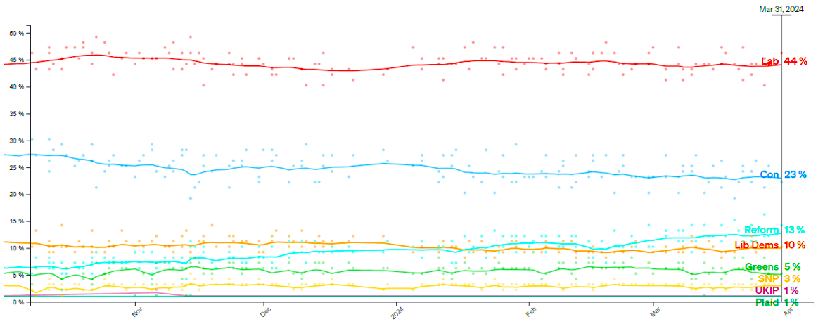
Polling – last 6 months
source: https://www.politico.eu/europe-poll-of-polls/united-kingdom/

Slide 5
Top issues for voters
 | April 2024 | June 2024 | Lab vs Con (June)
The Economy | 51% | 52% | 28% / 23%
Health | 45% | 50% | 43% / 9%
Immigration | 36% | 40% | 24% / 15%
Housing | 24% | 24% | 35% / 10%
Source: https://yougov.co.uk/topics/society/trackers/the-most-important-issues-facing-the-country

Slide 6
Recent history – volatile, shifting electorate
2010 | 2015 | 2017 | 2019 |  | 2024?
Lib Dem high tide | Orange wall collapsed UKIP neutralised SNP banished Labour from Scotland | Return of 2 party election UKIP collapse Brexit realignment | Red wall collapsed Brexit party neutralised SNP retains grip |  | Collapse of blue wall? Can Reform be neutralised? Collapse of SNP tartan wall? Does George Galloway / Aspire dent Labour?
Third parties’ impact on 2 party system

Slide 7
Parliamentary arithmetic
[as of 22 June 2024]
7
Source: https://www.electoralcalculus.co.uk/prediction

Slide 8
Election scenarios
 | Labour landslide | Labour majority government Leadership able to appoint Ministerial team of choice; pursue manifesto agenda. Greater ability to take tough decisions on tax, spend and foreign policy.
 | Labour biggest party, no majority | Alliance with Lib Dems, Plaid Cymru and/or SNP Labour backbenchers have more influence – leftward pull More interventionist incl. on climate. Electoral reform? Greater divisions on foreign policy. Stronger push on EU relations?
 | Conservatives biggest party, no majority | Alliance with Reform and/or DUP No prospect of strengthening EU ties. Net Zero policy reversals. Tougher immigration stance. Deregulation. Tax cuts. Less active foreign policy / stronger links with a Trump US

Slide 9
Next 3 weeks
4 July 2024
Polling day
5 July 2024
Appointment of Prime Minister: Formation of new government begins.
9 July 2024
Parliament: New Parliament meets and MPs are sworn in.
17 July 2024
Legislative programme announced: State Opening of Parliament and King’s Speech.

Slide 10
What next?
Party leadership contest
13 October: First 100 days
Mansion House speech
Party conferences
New European Commission 🇪🇺
Spending Review
End of July?
September - October
Autumn
Autumn / winter
5 July
September?
Early October?
5 November
Appointment of Prime Minister
Global Summit for Investment
Budget
US presidential election 🇺🇸
13 October: First 100 days

Slide 11
Pledges, policies and priorities

Slide 12
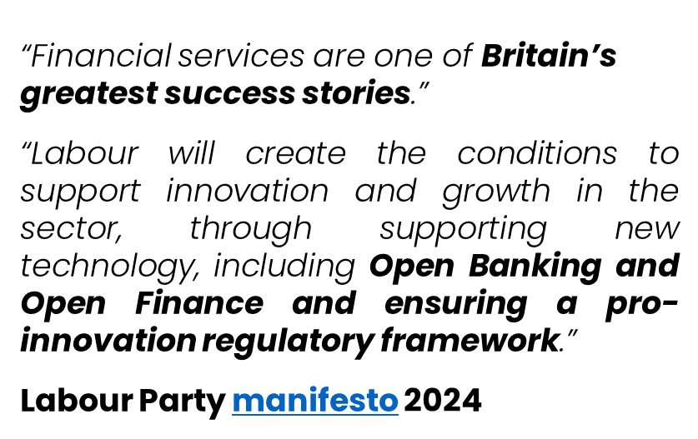
Continuity?
“We will build on the policies set out in the Edinburgh Reforms so that the UK continues to be the world’s most innovative and competitive global financial centre.”
“We will support the City of London’s position as the leading global market through the implementation of the Mansion House reforms.”
Conservative Party manifesto 2024

Slide 13
Tax: some consistency….
Corporation tax
Corporation tax will not be raised.
Corporation tax
Corporation tax will be capped at the current level of 25% for the entire Parliament.
They will retain a permanent full expensing system for capital investment and the annual investment allowance for small business.
Income tax
The rate of income tax will not be raised.
VAT
To support SMEs, the VAT threshold will be kept under review and options to smooth the cliff edge at £90,000 will be explored.
Income tax & VAT
will not be raised.

Slide 14
… some dividing lines
National Insurance
National Insurance will be cut by 2p, eventually reaching 6% by April 2027.
The self-employed will see the main rate of National Insurance abolished entirely by the end of the next Parliament.
National Insurance
will not be raised.
Business tax
A roadmap for business taxation for the next Parliament will be published within 6 months.
Inheritance tax
The use of offshore trusts to avoid inheritance will be ended.
Non-dom
Non-dom status will be abolished. and replaced by “a modern scheme for people genuinely in the country for a short period”.
Capital gains tax
Capital gains tax will not be raised.
Capital gains tax
The “carried interest tax loophole” will be closed.

Slide 15
Some post-election Parliamentary dynamics?

Slide 16
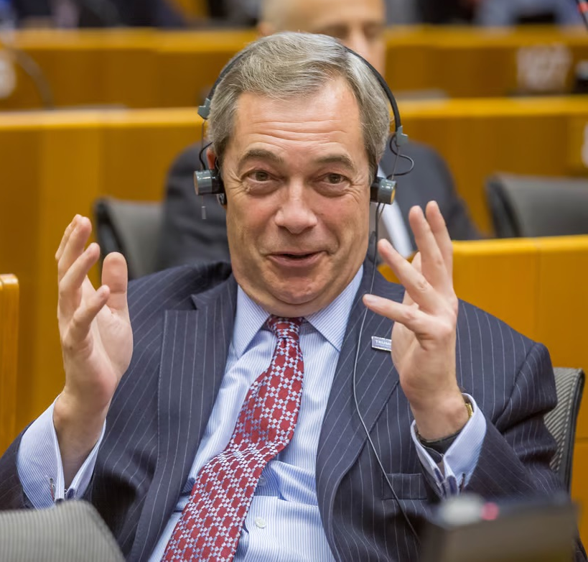
Reform UK commitments
Uphold British culture, identity and values
Reject the influence of the World Economic Forum.
Scrap Diversity, Equality and Inclusion (DE&I) rules
Net Zero is crippling our economy
Scrap Net Zero subsidies, including for renewables. Scrap Net Zero objectives for infrastructure.
Fast-track clean nuclear energy with new Small Modular Reactors, built in Britain. Increase and incentivise ethical UK lithium mining for electric batteries, combined cycle gas turbines, clean synthetic fuel, tidal power and explore clean coal mining.
Raise National Insurance for foreign workers
The National Insurance rate will be raised to 20% for foreign workers. Essential foreign health and care workers would be exempt, as would businesses who employ 5 staff members and under.
Scrap EU regulations
Highlighting retained EU laws, Reform will legislate to scrap EU regulations with immediate effect.

Slide 17
Conservative pledges
International Trade
We will complete free trade agreements with India and with the Gulf Cooperation Council and continue to pursue free trade agreements with countries such as Israel and Switzerland.
We will build on the UK-EU Trade and Cooperation Agreement but will not agree to anything in the forthcoming review that would infringe our legal sovereignty or involve submission to the CJEU or dynamic alignment
A pragmatic and proportionate approach to Net zero
Treble our offshore wind capacity,
Build the first two carbon capture and storage clusters,
Scale up nuclear power: approve two new fleets of Small Modular Reactor in first 100 days; halve the time it takes for new nuclear reactors to be approved, by allowing regulators to assess projects while designs are being finalised, improving join-up with overseas regulators assessing the same technology

Slide 18
Liberal Democrat pledges
Corporate governance
Reform fiduciary duty and company purpose rules to ensure all large companies have a formal statement of corporate purpose (incl. considerations such as employee welfare, environmental standards, community benefit and ethical practice), and report formally on their wider impact
Financial services & Net Zero
Regulating financial services to encourage climate-friendly investments, including requiring pension funds and managers to show that their portfolio investments are consistent with the Paris Agreement, and creating new powers for regulators to act if banks and other investors are not managing climate risks properly.
Infrastructure
Increase investment in green infrastructure, including renewable energy and zero-carbon transport, industry and housing and give a clearer zero-carbon remit to the UK Infrastructure Bank.
Tax
Work with partners in international forums, including OECD and UN, to tackle international corporate tax avoidance and make the case for increasing the global minimum rate of corporation tax to 21%.
.
Employment rights
Shifting the burden of proof in employment tribunals regarding employment status from individual to employer.

Slide 19
What would a Labour government do?

Slide 20
Labour’s 5 Missions
Get Britain building again: Growing the economy on secure foundations will be the number one mission of the next Labour government, securing the highest sustained economic growth in the G7.
Create Great British Energy: a new publicly-owned clean power generation company: “Key to the success of our plans is upgrading the national grid so that we have the infrastructure we need to move forward”.
Rebuild NHS : Pay doctors and nurses overtime to cut backlog, paid for by ending non-dom tax break; reform and modernisation including technology.
Make Britain’s streets safe, halving serious violent crime.
Break down barriers to opportunity for all: reforming childcare and education, prepare young people for work and life.

Slide 21
Labour pledges
Regulators and regulation
A new Regulatory Innovation Office will be created, bringing together existing functions across government.
This Office will help regulators update regulation, speed up approval timelines, and co-ordinate issues that span existing boundaries.
Investment
Labour will act to increase investment from pension funds in UK markets and adopt reforms to ensure that workplace pension schemes take advantage of consolidation and scale.
A review of the pensions landscape will be undertaken to consider steps needed to improve pension outcomes and increase investment in UK markets.
Artificial intelligence
Labour have pledged to ensure its industrial strategy supports the development of AI.
Binding regulation will be introduced “on the handful of companies developing the most powerful AI models” to ensure the safe development and use of AI models.
Right to switch off
Labour will follow similar models to those that are already in place in Ireland or Belgium.
This was announced in Labour’s Plan to Make Work Pay.

Slide 22
Labour pledges on Climate Change
Climate Resilience
Preparing for the future not only means tackling the climate and nature emergencies, but also adapting to the changes they will bring to our environment. Without action, flooding and coastal erosion will pose greater risks to lives, livelihoods and people’s wellbeing. Labour will improve resilience and preparation across central government, local authorities, local communities, and emergency services.
Energy and heating
A commitment to work with the private sector, including banks and building societies, to provide further private finance to accelerate home upgrades and low carbon heating.
Green Finance & Net Zero
Britain’s world-leading financial services industry has a major role to play in mobilising trillions of pounds in private capital to address climate change. Labour will make the UK the green finance capital of the world, mandating UK-regulated financial institutions – including banks, asset managers, pension funds, and insurers – and FTSE 100 companies to develop and implement credible transition plans that align with the 1.5°C goal of the Paris Agreement.

Slide 23
What is Rachel Reeve’s ‘Securonomics’?
Partnership with business | Limited Tax rises | Public spending discipline | Business investment | Reforming planning
Focus business engagement on policy missions. Backs Lord Harrington Review of Foreign Direct Investment – more active management and engagement with investors More dialogue between regulators and Ministers for more joined up policy | Corporation tax headline rate capped at current 25%. May be reduced if not competitive. Maintain full expensing and publish a roadmap for business taxation No mansion tax; no rise in 45p top rate. CGT – may change scope (incl carried interest)? rather than rates | Strengthened Office for Budget Responsibility Fiscal rules: no borrowing for day-to-day spend; reduce debt as share of GDP | £7.3 bn National Wealth Fund. Coinvesting in steel ports Giga-factories hydrogen greening carbon- intensive industry British Infrastructure Council | Commitment to ‘bulldoze’ through planning delays and NIMBYs for housing and infrastructure New towns in ‘grey belt’ Fast track high density housing on brownfield sites
Notes:
OBR – in law requirement that spend or tax changes require independent forecast
Single autumn budget by November
Steel: investing £2.5bn in a bright future for our steel industry, benefiting communities in Cardiff, Rotherham, Sheffield, Port Talbot and Scunthorpe. This reflects our original £3bn commitment, of which £500m is now in the government’s spending plans. Due to the perilous state of the steel industry, we are accelerating this scheme from over ten years to five.
• Ports: upgrading our ports so they are renewable-ready, with an investment of £1.8bn, which would inject investment into nine clusters, including; Forth and Tay, Humber, East Anglia, Solent, North West and North Wales, Belfast Harbour, North East Scotland, North East England and the Celtic Sea.
• Gigafactories: breaking the ground for new electric vehicle and battery factories, with £1.5bn investment in our automotive heartlands in the West Midlands, the North East, and the South West. This is in addition to the £500m already committed by the UK Government.
• Industrial hubs: decarbonising carbon-intensive heavy industrial hubs in every corner of the country, with an investment of £1bn, benefiting Scotland, South Wales, the Humber, Teesside and Merseyside.
• Hydrogen: channelling up to £500m into green hydrogen manufacturing, which could benefit the North West, Sheffield and the South East. 
Grey bely: unused land in green belt eg car parks etc

Slide 24
Labour Industrial Strategy
Industrial Strategy
Statutory Industrial Strategy Council to assess effectiveness of Government delivery.
Four missions: Clean power by 2030; harness data for public good; caring for the future; build more resilient economy.
Four pillars:
Sovereign capabilities: Critical infrastructure and industry;
Global champions: Particularly services and financial services;
Future successes: Including advanced materials, bioengineering, quantum computing, cleantech, cyber security, carbon capture and robotics; and
Everyday economy: Including retail, hospitality and leisure and cares services.
Key sectors: Life sciences, advanced manufacturing, creative industries, hydrogen economy, academia.

Slide 25
Labour Financial Services Review
Enhance the international competitiveness of the UK’s financial services sector
Joined-up, Regulatory Innovation Office to improve accountability and promote innovation in regulation across sectors. It will promote transparency on regulator performance, including the new metrics for the FCA and PRA to demonstrate progress towards the secondary objective on growth and competitiveness.
Innovation-centred approach to regulation and supervision including RegTech/SupTech, and adapt oversight to accommodate innovative technologies and business models.
Streamline the regulatory rulebook to align with the Consumer Duty.
Expand the UK’s agreements with international financial centres to increase financial services trade, including Singapore, Switzerland, and Japan.
EU: Seek to build on the UK-EU Financial Services MoU. Work to secure comprehensive arrangements for mutual recognition of professional qualifications with the EU. Explore opportunities to reduce barriers to trade in areas where our regulations deliver similar outcomes, including finding a sustainable solution for cross-border clearing.
Embrace innovation and FinTech as the future of financial services
Set international standards for the use of Artificial Intelligence (AI) in financial services, and an agile approach to regulation.
Make the UK a global hub for securities tokenisation.

Slide 26
Labour Financial Services Review
Reinvigorate our capital markets
British ‘Tibi’: Opt-in for DC funds to invest a proportion of their assets into UK growth.
Increase investment by institutional and individual investors in UK capital markets and increasing investment in infrastructure and green industries through Solvency UK reforms.
Lead the world in sustainable finance
Deliver a world-leading green finance regulatory framework
Require financial institutions and FTSE 100 companies to publish their carbon footprint and adopt credible 1.5-C aligned transition plans.
A clear timeline for completion of the green taxonomy, and voluntary and mandatory reporting for all businesses in scope.
Take forward the disclosure framework and sectoral guidance developed by the Transition Planning Taskforce and determine a clear timeframe for instituting voluntary and mandatory transition planning and disclosure requirements
Explore the potential for nature-related finance building on the work in the voluntary carbon markets and natural capital public-private partnerships.

Slide 27
So what? - Opportunities and risk

Slide 28
The gamble on growth without fiscal stimulus:
Opportunity
Growth will require focused supply side reforms:
Regulatory competitiveness to reduce unnecessary burdens and regulation that enables growth and innovation
Private sector investment to finance infrastructure and green transition
Tackling trade barriers, incl EU
Risk
If this is not achieved quickly, there will be more volatility
And Chancellor may naturally look to banks and asset managers and not to commercial risk market unless we demonstrate how the London market can help deliver economic mission rapidly and at scale

Slide 29
Four areas to consider
 | Financing infrastructure and green transition | How can you de-risk finance and provide impartial advice?
 | Regulatory innovation | How can we maintain Ministerial pressure on regulators to focus on competitiveness and growth? Can we secure greater distinction between retail and commercial markets?
 | Geo-political risk and volatility | How can the London market be the advisers to Government on managing risk? USA and France may make UK look a more attractive, stable place to do business
 | Trade negotiations | What do we need from any EU-UK financial services negotiation? And what priorities for rest of the world?

Slide 30
Any questions?

